Slide 1

Solving a Word Search
Design and Analysis of Algorithms for
Created in collaboration with students such as:
Chase
Ryan
John
And Austin

Slide 2

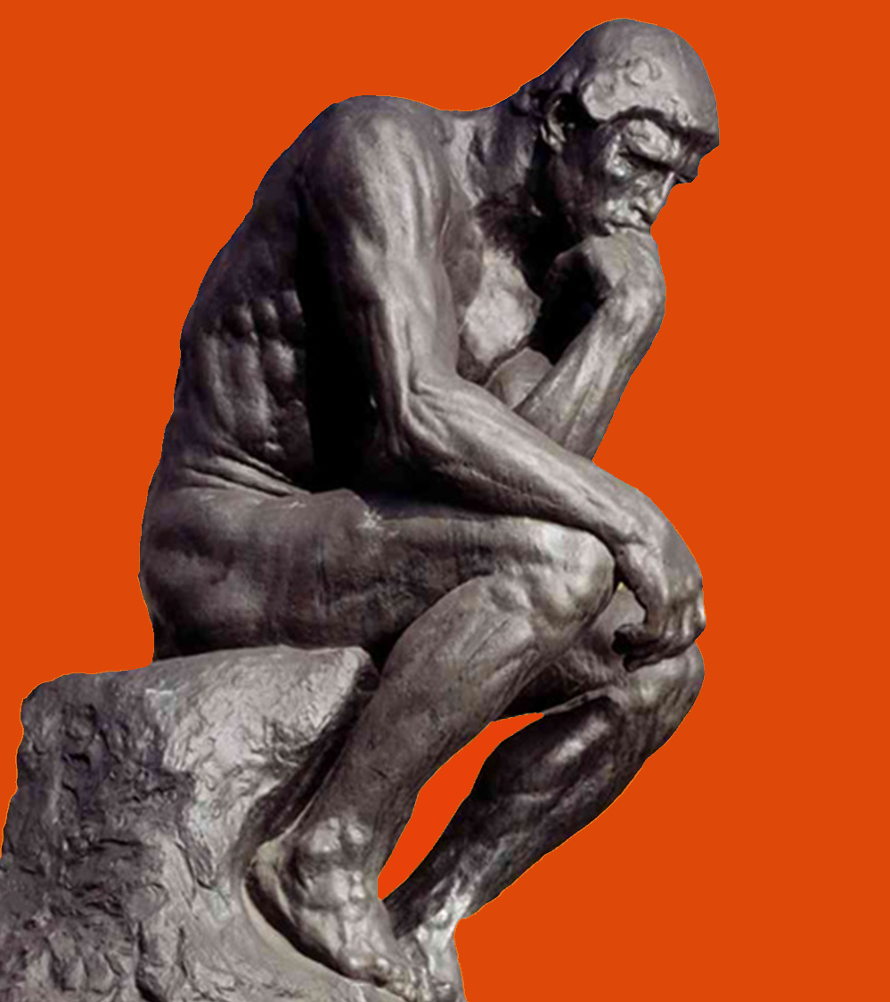

Our Problem
In Natural Language:
Find all words in a given word list within a board of randomly generated characters
Aka Word Search Puzzle

Slide 3
Our Problem: Stated Formally
Variables:
B_{i, j} = matrix of letters comprising game board, i & j indicate position
W_{L} = List of words to find ex: [w₁, w₂, w₃, w₄, …]
W = a unique sequence of M alphabetic characters
M = number of characters in a word
N = number of characters in a sequence
S = sequence of characters for any w ϵ W_{L}
D = list of directions
[up, down, left, right, down-left, down-right, up-right, up-left]

Slide 4
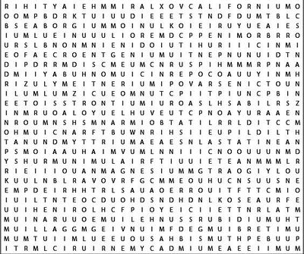

Formal Statement
Alabama
Alaska
Arizona
Arkansas
California
Colorado Connecticut
“For all words W in word list W_{L} such that the first character in Word w_{k} exist in the Board B at some given coordinate (i,j)…
{
AND
B
The sequence S_{k} of word w_{k} is equal to sequence S_{o} where S_{o} is all combinations of sequences around B_{i, j}”
W_{L}
If this statement returns true, the word w_{k} exist in board B
{∀ w ϵ W_{L} | (w_{k}[0] B_{i, j}) ∩ (S_{k} = B_{i, j} + (S_{k}-S_{k}[0]) ∀ D_{e} ϵ D | N_{k} = M_{k})} = T/F
This Photo by Unknown Author is licensed under CC BY-NC

Slide 5
Our Algorithms
Brute
Force
Boyer-Moore
Bear Method
Rabin–Karp
Check every spot until the word is found, for every word.
***insert
short
description
here***
Put all letters on the board in hash maps sorted by letter to find words.
***insert
short
description
here***

Slide 6
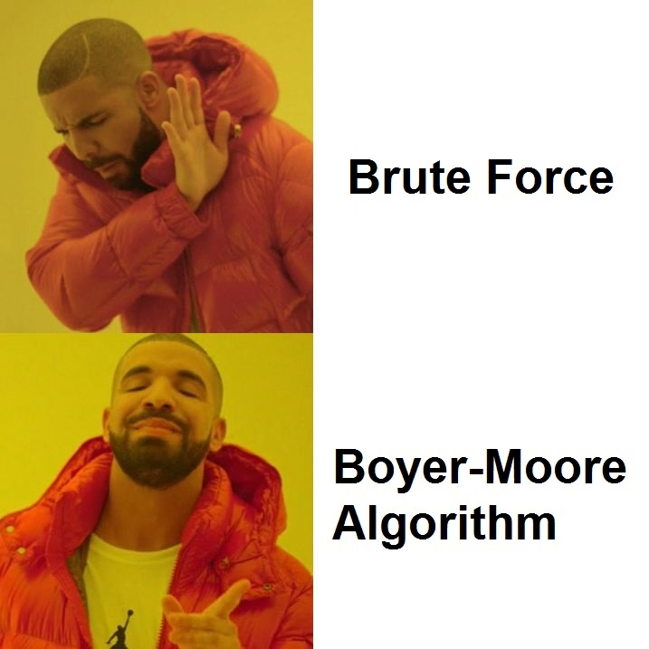
First Hypothesis
We predict…
Boyer-Moore will be the most efficient algorithm when dealing with a larger data set.
That when changing the constraints to our problem, the performance of each algorithm will be affected.

Slide 7
New Hypothesis

Slide 8
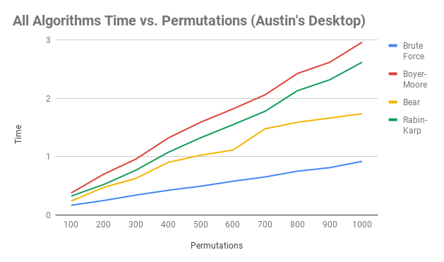
Results: 50x50 Board, 50 Words
These Results are with Pre-Processing included in our timed results.
Fastest to slowest in descending order:
Brute Force
Bear Method
Rabin-Karp
Boyer Moore

Slide 9

Questions?

